Slide 1
Employees Data Analysis with Excel
Student Name : YOGARAJU K
Register No : User ID : autunm110312201296
9CEEE6E20F3A9E1BA4A4AA2B06B091D8
Department : III B. COM ( GENERAL)
College : DRBCCC Hindu College

Slide 2
Project Title
Employee Business Unit Analysis
Employee Department Type Analysis
Employee Pay Zone Analysis
Employee Type of Job Analysis

Slide 3

Agenda
Problem Statement
Project Overview
End Users
Our Solution and Proposition
Dataset Description
Modelling Approach
Results and Discussion
Conclusion

Slide 4
Problem Statement
The problem statement is analysing employee job type, pay zone, business unit and department to optimize allocation and productivity.
Optimizing worforce allocation through data analysis.

Slide 5
Project Overview
Analyzing employee job types, pay zones, business units, and department types to identify trends, optimize workforce allocation, and inform strategic talent management decisions.
Examinig key employee attributes to uncover insights, enhance workforce alignment, and drive data-informed decisions that support business objectives.

Slide 6

Who are the End Users?
Key Statement :
HR Managers, Talent Acquisition Teams, Business Unit Leaders, and Department Heads who will utilize insights for informed decision-making.
End Users :
HR professionals, business leaders, and department managers seeking to optimize workforce planning talent management, and organizational design.

Slide 7
Who are the End Users?
Target Audience :
Internal stakeholders requiring data-driven insights to enhance employee utilization, talent development, and business performance

Slide 8

Our Solution and Proposition
Unlocking workforce potential through data analysis and actionable insights empowering HR and business leaders to make informed decisions and drive business growth.
Transforming workforce data into strategic insights , enabling organizations to optimize talent management , improve employee utilization ,and achieve business excellence

Slide 9
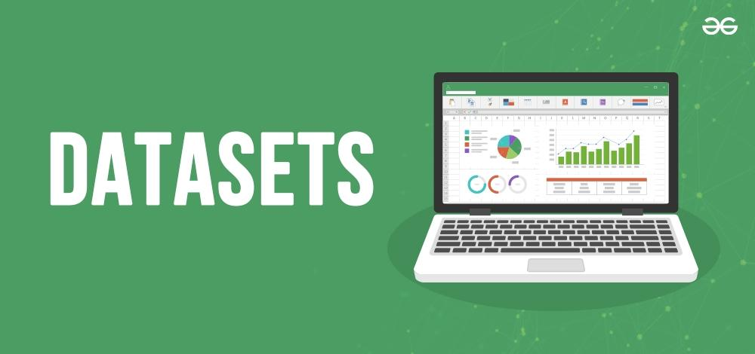
Dataset Description
Our data provides a comprehensive view of employee attributes, including Job Type, Business unit, and Department type, enabling analysis of workforce trends, distribution, and insights.
This dataset captures key employee information across four dimensions: Job Type, Pay Zone, Business Unit, and Department Type, supporting informed decision-making and workforce planning.

Slide 10
Modelling Approach
To uncover insights, we employed a multi-variable analysis approach, examining the relationships between Employee Job Type, Pay Zone, Business Unit, and Department Type.
Our modelling approach involved a comprehensive examination of employee attributes, including Job Type, Job Zone, Business Unit, and Department Type, to identify key trends and correlations.
Using a combination of statistical and machine learning techniques, we analyzed the interactions between Employee Job Type, Pay Zone, Business Unit, and Department Type to inform our findings.
To gain a deeper understanding of our approach, exploring the connections between Employee Job Type, Pay Zone, Business Unit, and Department Type.

Slide 11
Results of Employee Type of Job

Slide 12
Results of Employee Pay Zone

Slide 13
Results of Employee Business Unit

Slide 14
Results of Employee Department Type

Slide 15
Conclusion
Our analysis provides key insights into employee attributes, enabling informed decision-making.
Data-driven insights into Employee Job Types, Pay Zones, Business Units, and department types inform HR, initiatives and business decisions. This analysis empowers data-informed decisions and optimized workforce planning. Key trends and correlations identified, driving business growth and optimization. Insights gained, informing future workforce planning and strategy.

